Slide 1
RESTful Web Services with Spring Boot

Slide 2
Objectives
Understand REST Principles
Master HTTP Methods
Spring Boot for REST
Spring Boot RESTful Annotation
Demonstration 3-Layer Architecture with Spring REST

Slide 3
What is REST?
REST (Representational State Transfer): An architectural style for designing networked applications.
Core Concepts:
Client-Server: Separation of concerns between the frontend (client) and backend (server).
Statelessness: Each request from the client to the server must contain all the information necessary to understand the request.
Cacheability: Responses from the server must explicitly state whether they can be cached or not.
Uniform Interface: Defines the interface between clients and servers.

Slide 4
What are RESTful Web Services?
Architectural style for distributed systems
Leverages HTTP protocol for communication
Emphasizes resources and their representations
Key elements:
Resources: Identified by URIs (e.g., /users/123)
HTTP verbs: GET, POST, PUT, DELETE for actions
Representations: JSON, XML for data exchange

Slide 5
The Elements of RESTful APIs
Resources: Nouns that represent key entities in your system (e.g., users, products, articles). Resource is identified by unique URIs.
HTTP Methods: Verbs that define actions on resources.
GET: Retrieve a resource or collection of resources.
POST: Create a new resource.
PUT: Update an existing resource.
DELETE: Delete a resource.
HTTP Status Codes: Provide feedback to the client about the result of their request.

Slide 6
RESTful API Design Best Practices
Use nouns for resource names: /users, /products, not /getUser, /addProduct.
Keep URLs simple and consistent: Use hyphens (-) to separate words, not underscores (_).
Use HTTP methods correctly: Match the HTTP verb to the intended action.
Version your API: Allow for future changes without breaking existing clients (e.g., /v1/users).
Handle errors gracefully: Return appropriate status codes and informative error messages.
Document your API: Use tools like Swagger or OpenAPI to create clear and comprehensive documentation.

Slide 7
Benefits of RESTful APIs
Scalability: Easily handle a growing number of users and requests.
Flexibility: Support various clients (web, mobile, IoT) and platforms.
Interoperability: Communicate across different systems and programming languages.
Simplicity: Easy to understand and use compared to other approaches like SOAP.
Evolution: Adapt and change over time without disrupting existing clients.

Slide 8
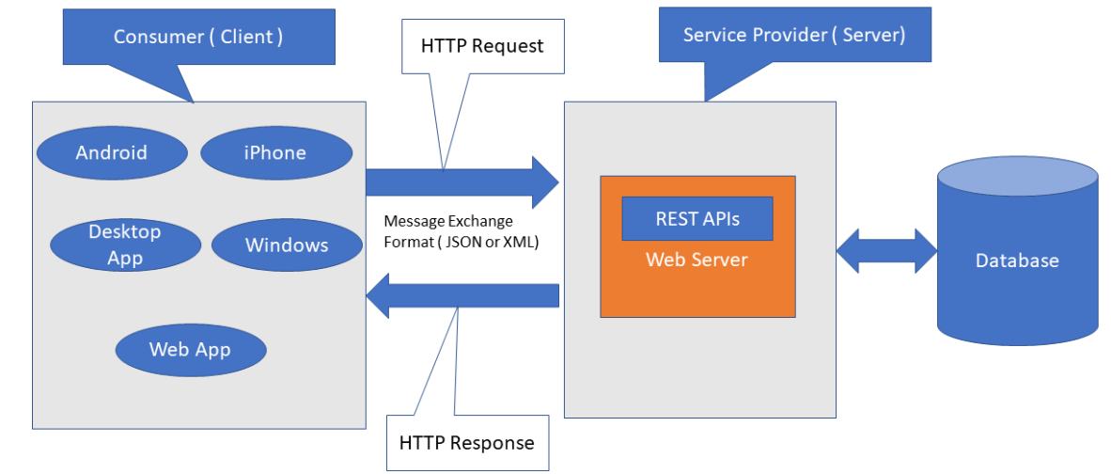
REST Architecture - 1
Client-server architecture: The client is the front-end and the server is the back-end of the service.
Stateless: No data should be stored on the server during the processing of the request transfer. The state of the session should be saved at the client’s end.
Notes:
https://www.javaguides.net/p/rest-api-tutorial.html

Slide 9
REST Architecture - 2
Cacheable - The client should have the ability to store responses in a cache. This greatly improves the performance of the API.
Uniform Interface - This constraint indicates a generic interface to manage all the interactions between the client and server in a unified way, which simplifies and decouples the architecture.
Layered System - The server can have multiple layers for implementation. This layered architecture helps to improve scalability by enabling load balancing.
Notes:
https://www.javaguides.net/p/rest-api-tutorial.html

Slide 10
URI - Uniform Resource Identifier
The resource can be identified by a Uniform Resource Identifier (URI). For web-based systems, HTTP is the most commonly used protocol for communicating with external systems. You can identify a unique resource using a URI.
GET - http://localhost:8080/api/products/: Returns a list of all items
GET - http://localhost:8080/api/products/2: Returns an item whose ID is 2
POST - http://localhost:8080/api/products/: Creates a new resource
PUT - http://localhost:8080/api/products/2: Updates a POST resource whose ID is 2
DELETE - http://localhost:8080/api/products/2: Deletes a resource

Slide 11
Sub-resource
In REST, the relationships are often modeled by a sub-resource. Use the following pattern for sub-resources.
GET /{resource}/{resource-id}/{sub-resource}
GET /{resource}/{resource-id}/{sub-resource}/{sub-resource-id}
POST /{resource}/{resource-id}/{sub-resource}

Slide 12
HTTP Status Code - 1
200 OK: This code indicates that the request is successful and the response content is returned to the client as appropriate.
201 Created: This code indicates that the request is successful and a new resource is created.
400 Bad Request: This code indicates that the server failed to process the request because of the malformed syntax in the request. The client can try again after correcting the request.
401 Unauthorized: This code indicates that authentication is required for the resource. The client can try again with appropriate authentication.

Slide 13
HTTP Status Code
403 Forbidden: This code indicates that the server is refusing to respond to the request even if the request is valid. The reason will be listed in the body content if the request is not a HEAD method.
404 Not Found: This code indicates that the requested resource is not found at the location specified in the request.
500 Internal Server Error: This code indicates a generic error message, and it tells that an unexpected error occurred on the server and that the request cannot be fulfilled.

Slide 14
Spring Boot
Spring Boot makes it easy to create stand-alone, production-grade Spring based Applications that developers can "just run".
Spring Boot Features
Create stand-alone Spring applications
Embed Tomcat, Jetty or Undertow directly (no need to deploy WAR files)
Provide opinionated 'starter' dependencies to simplify your build configuration
Automatically configure Spring and 3rd party libraries whenever possible
Provide production-ready features such as metrics, health checks, and externalized configuration
Absolutely no code generation and no requirement for XML configuration

Slide 15
Why Spring Boot for RESTful APIs?
Simplified development: Auto-configuration and starter dependencies
Embedded servers: No need for external servlet containers
Production-ready features: Health checks, metrics, and more
Microservices support: Ideal for building distributed systems

Slide 16
Benefits of Spring Boot for REST
Rapid Development: Quickly build and deploy APIs
Improved Productivity: Focus on business logic, not infrastructure
Enhanced Maintainability: Clean and organized codebase
Scalability and Reliability: Robust framework for production use

Slide 17
Spring Boot vs. Other Frameworks
Feature | Spring Boot | Other Frameworks (e.g., Jersey, RESTEasy)
Setup | Minimal configuration, auto-configuration | More manual configuration required
Embedded Server | Included (Tomcat, Jetty, etc.) | Requires separate setup
Dependency Management | Starter dependencies simplify inclusion | Manual dependency management
Microservices | Excellent support with Spring Cloud | May require additional libraries
Learning Curve | Relatively easy to learn and use | Can be steeper for beginners

Slide 18
Spring Boot RESTful Annotation (1)
@RestController - This annotation marks a class as a REST controller, indicating that it handles incoming HTTP requests and sends responses. It combines @Controller and @ResponseBody, meaning the controller's methods will directly return data that's serialized into JSON or XML (usually JSON by default).
@GetMapping, @PostMapping, @PutMapping, @DeleteMapping - Shorthand annotations for @RequestMapping to specify the HTTP method directly. These simplify the code by clearly indicating which HTTP method each endpoint handles.

Slide 19
Spring Boot RESTful Annotation (2)
@PathVariable - Extracts values from URI segments (parts of the URL) and binds them to method parameters. It allows to access dynamic parts of the URL.
@RequestBody - Binds the body of the HTTP request to a Java object.
It automatically deserializes the request body (usually JSON) into an instance of the specified class.
@ResponseBody - Marks a method's return value to be used as the response body. It serializes the returned object (usually into JSON) and sends it back in the HTTP response. This is automatically included in @RestController.

Slide 20
Spring Boot RESTful Annotation (3)
@ResponseStatus - Sets the HTTP status code for a response. Can use it to indicate success (200 OK), creation (201 Created), or error conditions (404 Not Found, 500 Internal Server Error).
code: Specifies the HTTP status code (e.g., HttpStatus.OK, HttpStatus.CREATED).
reason: Specifies a custom reason phrase for the status code.

Slide 21
Spring Boot RESTful Annotation (4)
@RequestParam - Extracts values from query parameters and binds them to method parameters.
value: specifies the name of the query parameter.
required: indicates whether the parameter is required.
defaultValue: specifies a default value if the parameter is not present.
@ExceptionHandler - Handles exceptions thrown by controller methods.
@ControllerAdvice - Defines a global exception handler that can handle exceptions from multiple controllers.

Slide 22
Spring Boot RESTful Annotation (4)
@RequestMapping - Maps HTTP requests to specific controller methods. Can map requests based on:
value: specifies the request path.
method: specifies the HTTP method (e.g., RequestMethod.GET, RequestMethod.POST).
params: specifies request parameters that must be present.
headers: specifies request headers that must be present.
consumes: specifies the content type of the request body.
produces: specifies the content type of the response body.

Slide 23
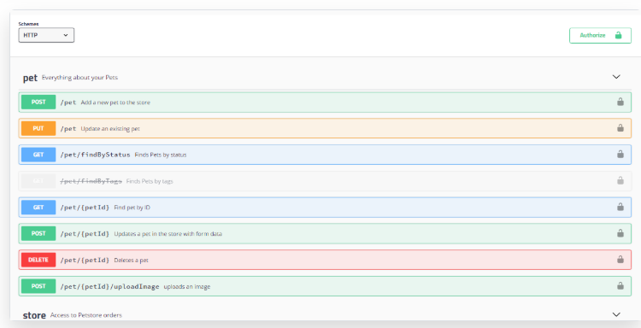
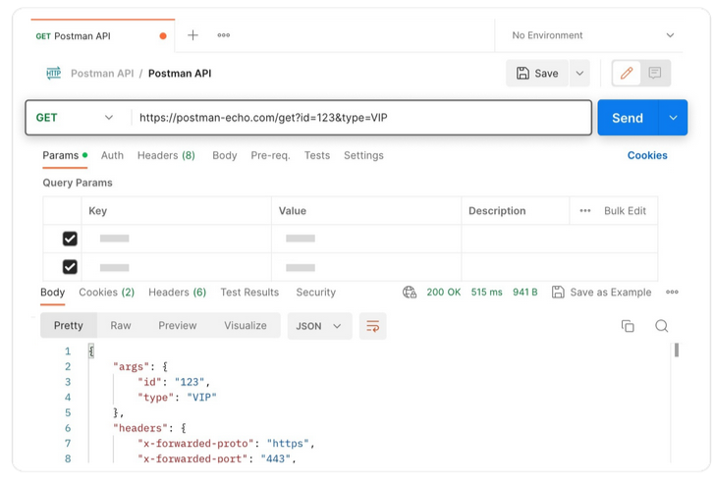
Accessing REST Applications
Browser extension
Postman (Chrome browser extension)
RESTClient (Firefox extension)
Graphical User Interfaces (GUIs)
Postman
Swagger UI
Insomnia

Slide 24
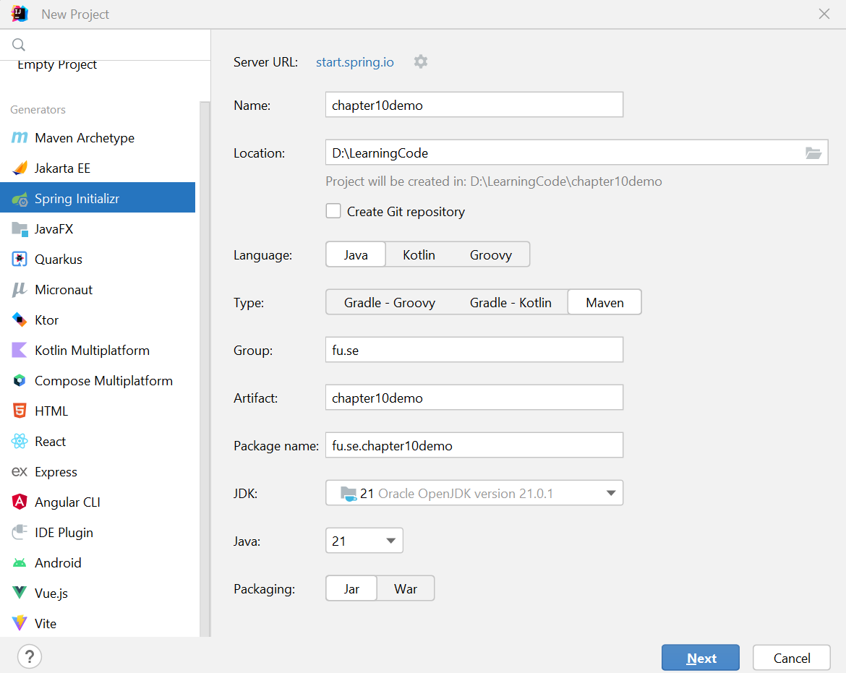
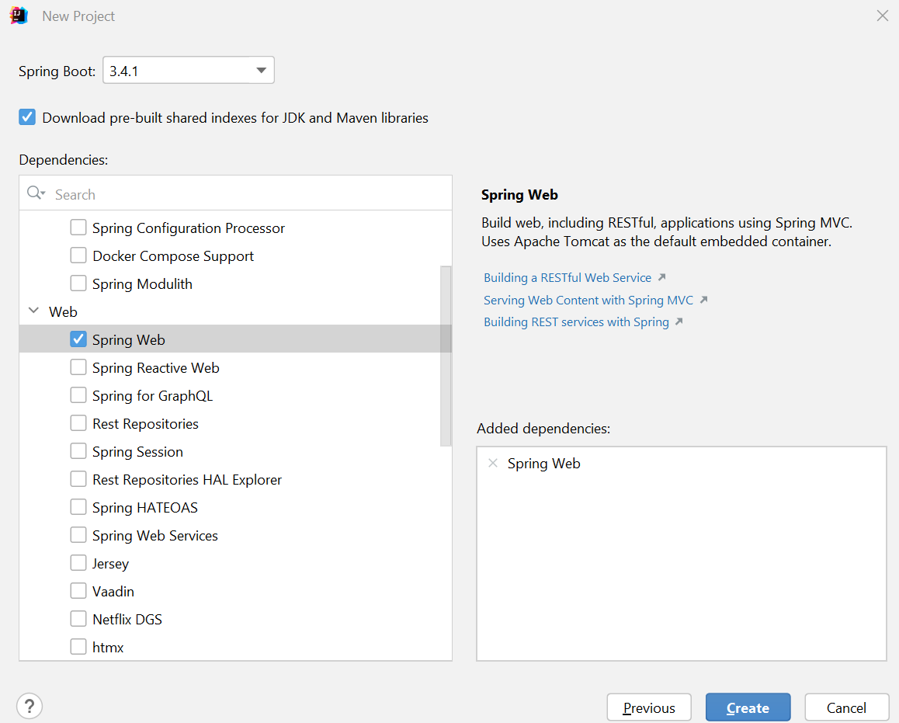
Demo 1. Spring Boot with IntelliJ IDEA - 1
Step 1. Create Project with IntelliJ IDEA
Step 2. Choose Spring Web dependency for building a RESTful Web Service

Slide 25
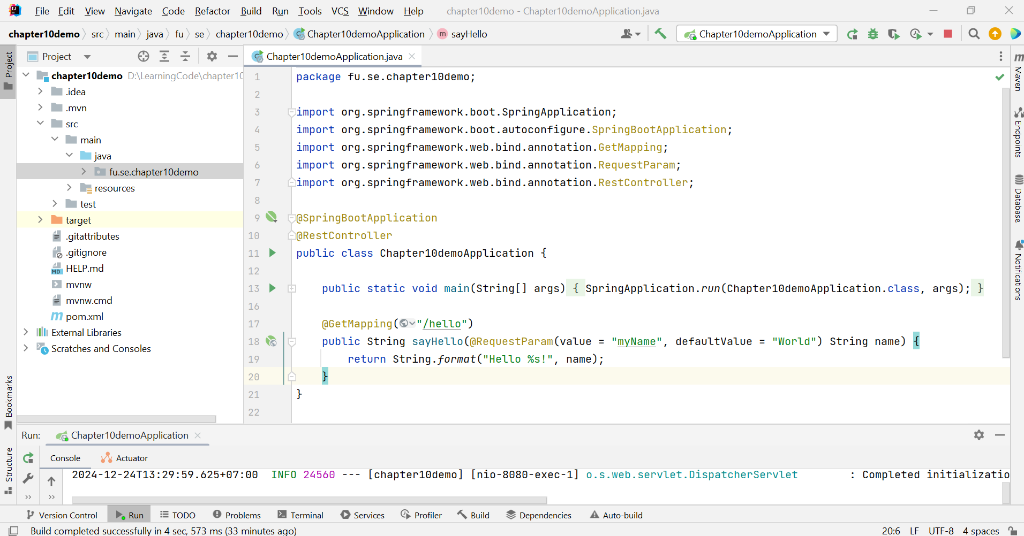
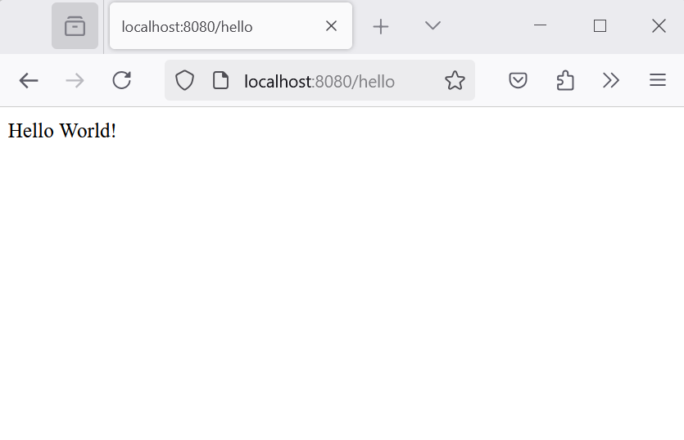
Demo 1. Spring Boot with IntelliJ IDEA - 2
Step 3. Create a simple GET Mapping
Step 4. Run the Project

Slide 26
Demo 2 - Simple CRUD RESTful Web Service
Step 1 - Project Setup
Initialize with Spring Initializr: start.spring.io
Choose the preferred language (Java), Spring Boot version (a recent stable version is recommended), and provide project metadata (Group, Artifact).
Add "Spring Web“ (all the necessary libraries for building RESTful services).
Generate the project and download the ZIP file.
Import into IDE: Extract the downloaded ZIP and import the project into IntelliJ IDEA

Slide 27
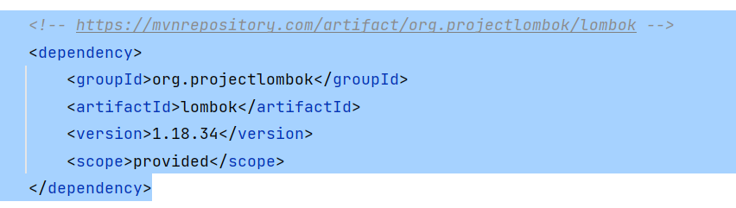
Demo 2 (contd.)
Step 2 – pom.xml file
Project Lombok (org.projectlombok) is a popular Java library that dramatically reduces boilerplate code. It does this through annotations, which are special markers that tell Lombok to generate code at compile time.
Getters and Setters: Instead of manually writing getters and setters for each field, can simply use the @Getter and @Setter annotations.
Constructors: @NoArgsConstructor, @RequiredArgsConstructor, and @AllArgsConstructor generate constructors.
toString(), equals(), and hashCode(): @ToString, @EqualsAndHashCode automatically generate these common methods.

Slide 28
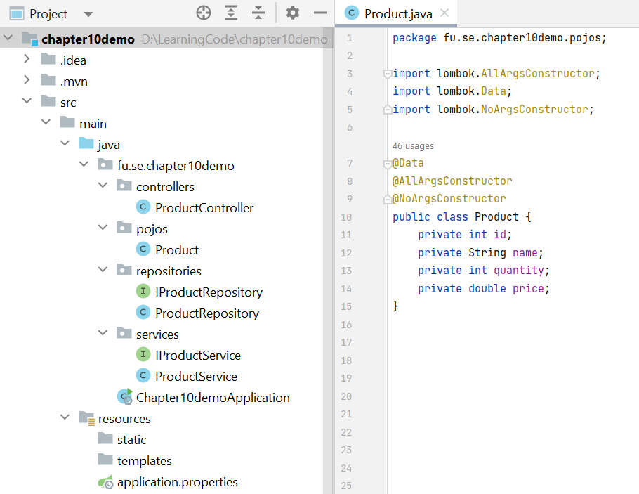
Demo 2 (contd.)
Step 3. Create a model class. Create a simple Java class to represent the data you want to manage in your CRUD operations.

Slide 29
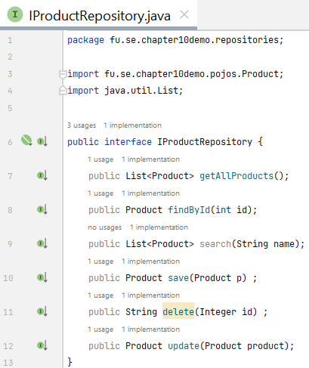
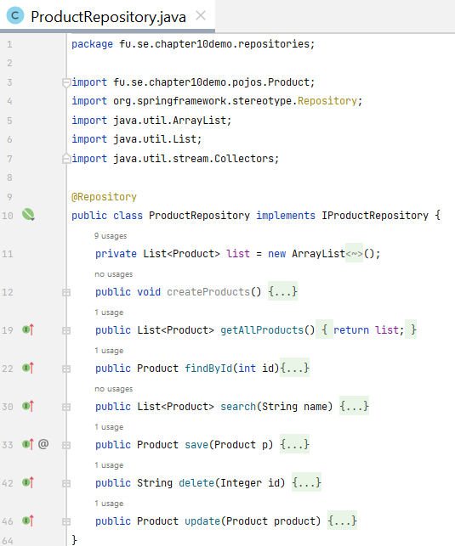
Demo 2 (contd.)
Step 4. Create repository interface and repository class

Slide 30
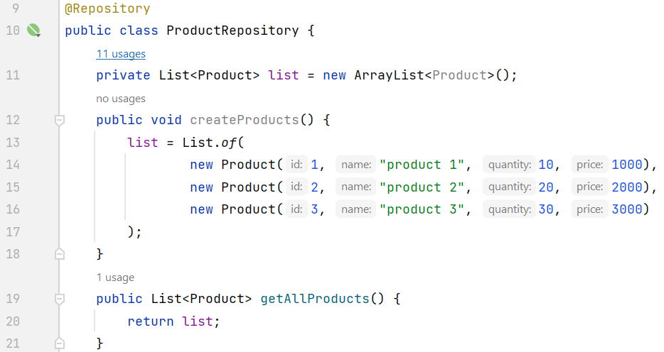
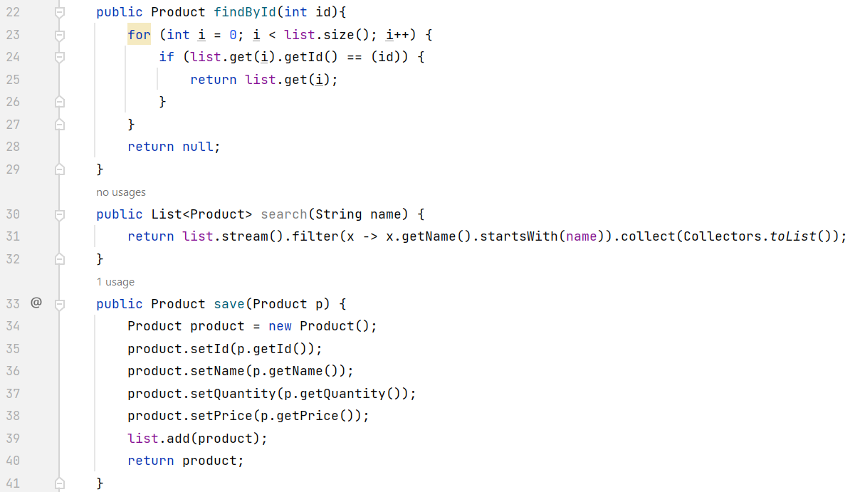
Demo 2 (contd.)
Step 4. Create a Repository Class - Function in details

Slide 31
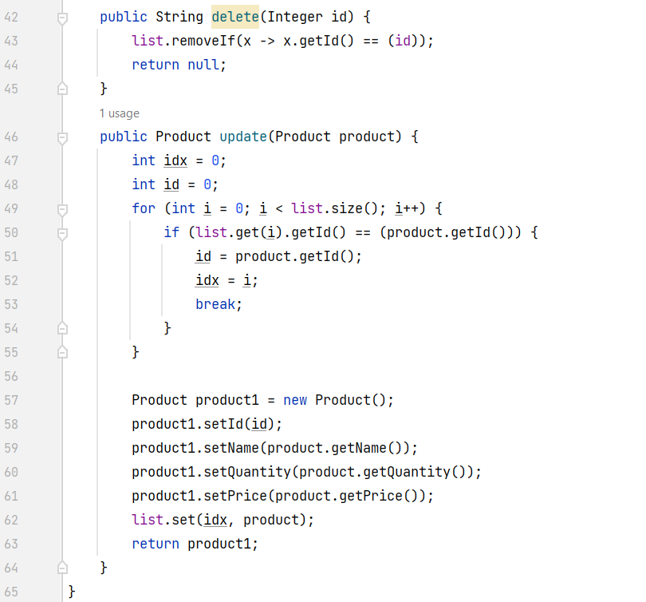
Demo 2 (contd.)
Step 4. Create a Repository Class - Function in details

Slide 32
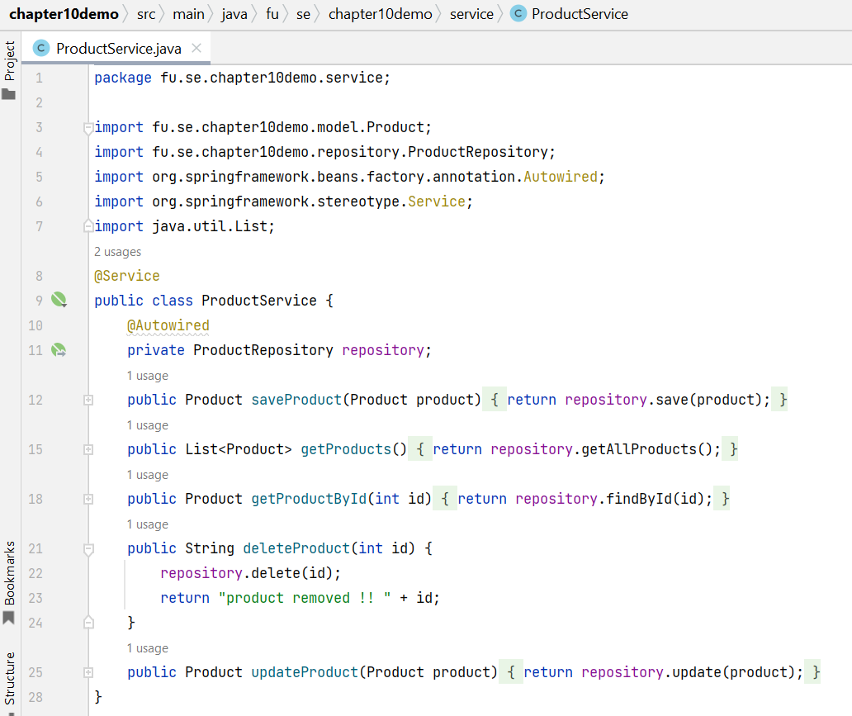
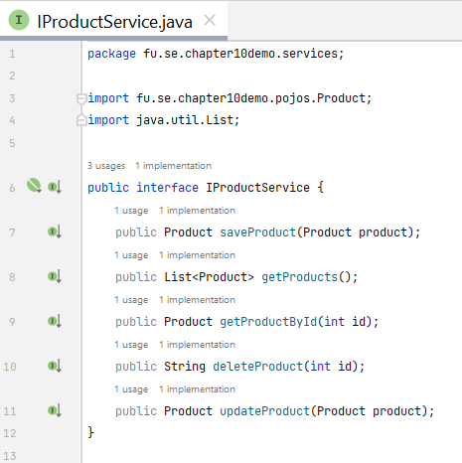
Demo 2 (contd.)
Step 4. Create service class and interface for Handling the business logic for CRUD operations. This keeps the controller clean and focused.

Slide 33
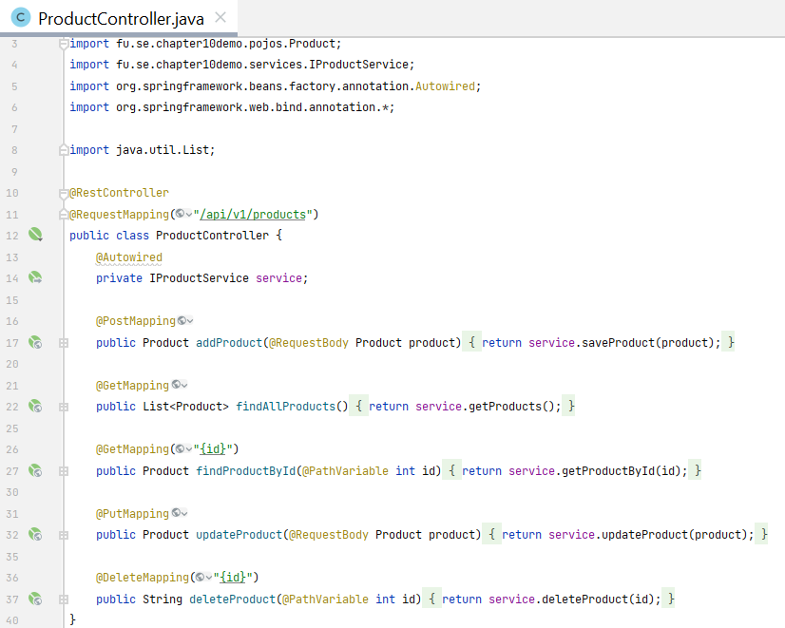
Demo 2 (contd.)
Step 5. Create a REST Controller

Slide 34
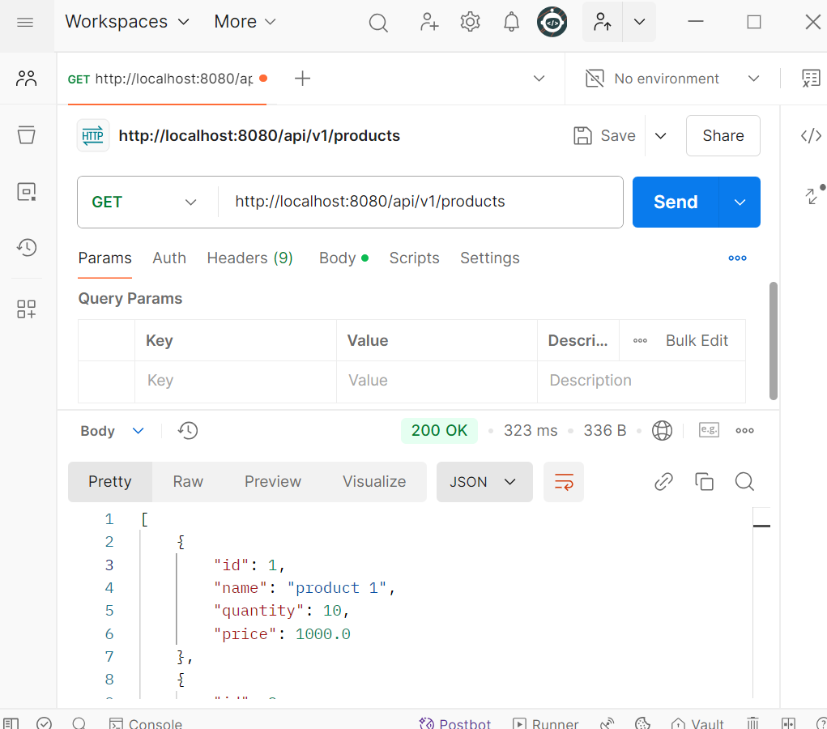
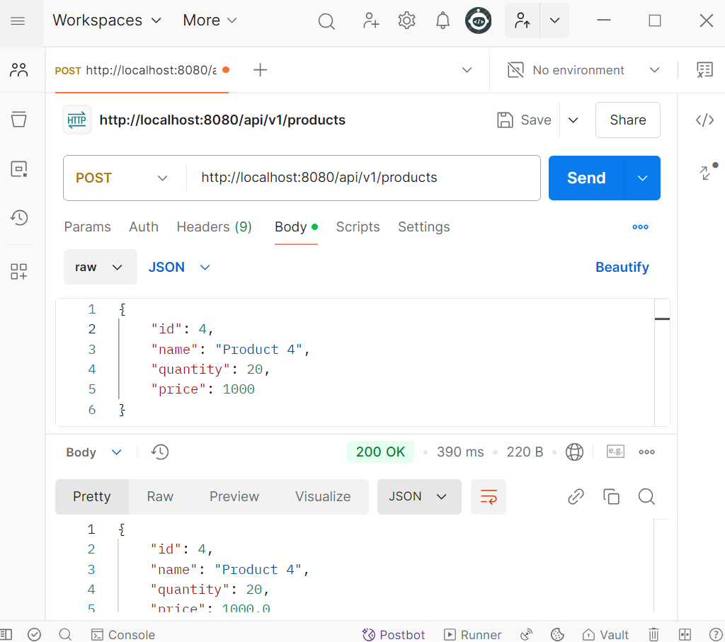
Demo 2 (contd.)

Slide 35
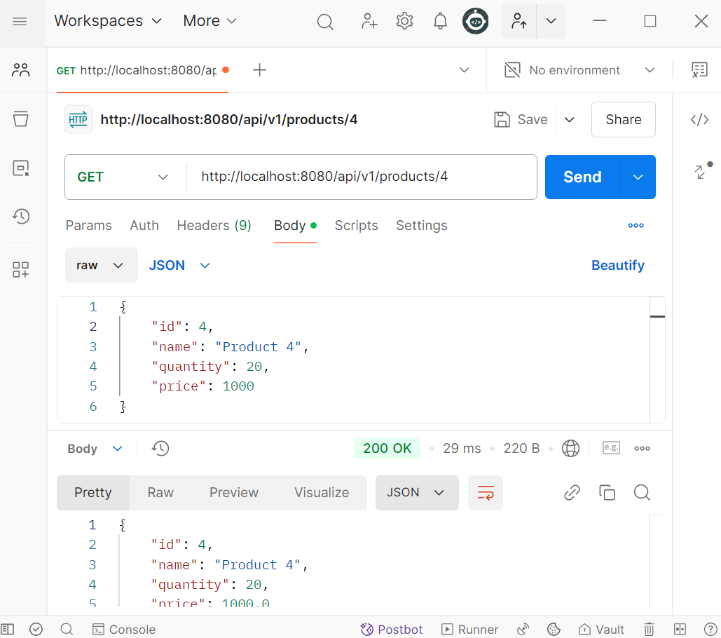
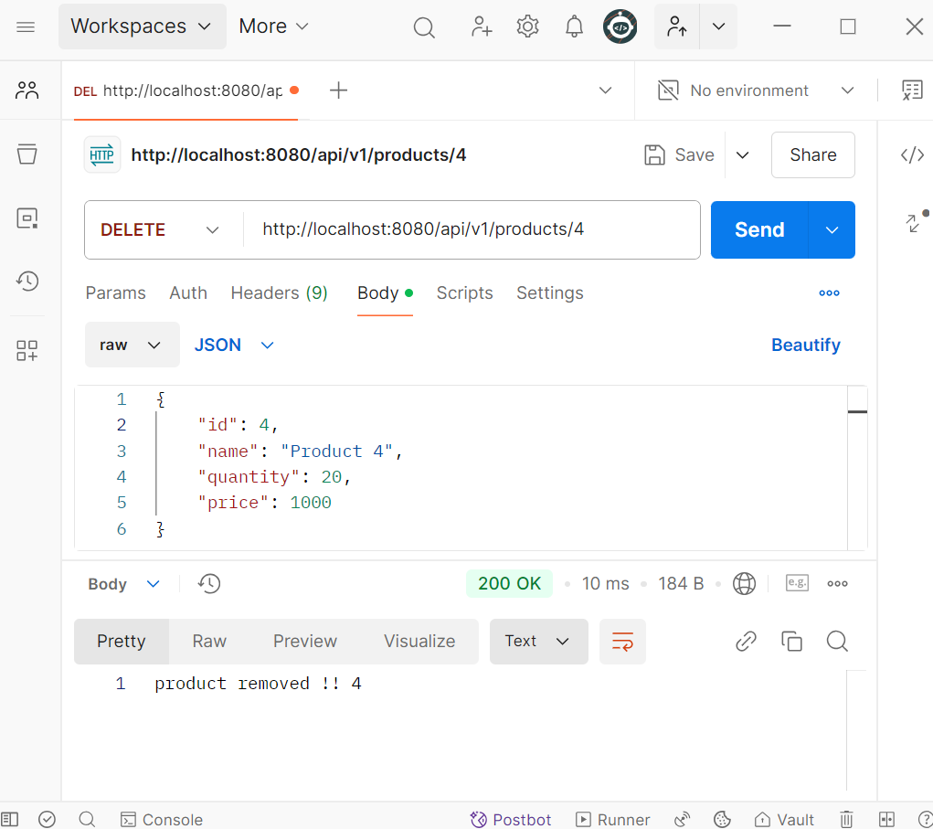
Demo 2 (contd.)

Slide 36
Summary
Concepts were introduced:
REST Principles
HTTP Methods
Spring Boot for REST
Spring Boot RESTful Annotation
Demonstration 3-Layer Architecture with Spring REST

